Slide 1
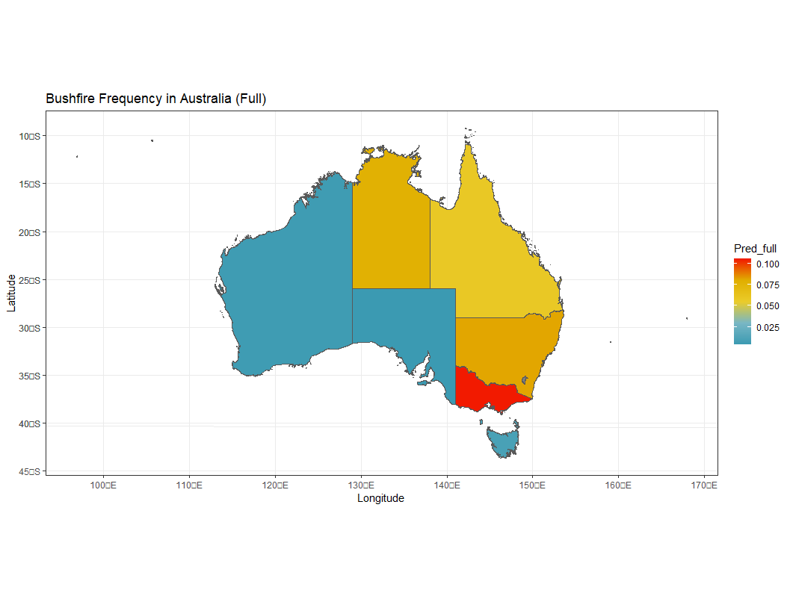
Model Scoring and Result Presentation
State | Bushfire Risk
Victoria | 0.106
New South Wales | 0.082
Northern Territory | 0.078
Queensland | 0.058
Tasmania | 0.01
Western Australia | 0.006
South Australia | 0.004

